Slide 1


SAP BTP Training
Cloud Foundry Training

Slide 2

DISCLAIMER
The training content and delivery of this presentation is confidential, and cannot be recorded, or copied and distributed to any third party, without the written consent of Anubhav Trainings

Slide 3

LEARNING OBJECTIVES
SAP BTP CAPM Development
Working with entity restrictions @readonly
OData V2 proxy
Create Actions and Custom Functions
Fiori Elements – Introduction
Tools for Fiori Development in BAS
Fiori Freestyle v/s Fiori Elements
Create Fiori App in CAP App

Slide 4
Run OData V2
OData V4 which is a latest version of OData version 2. SAP released a backward compatible module which converge the V4 capm services to OData v2.
The module is named as @sap/cds-odata-v2-adapter-proxy
www.anubhavtrainings.com

Slide 5
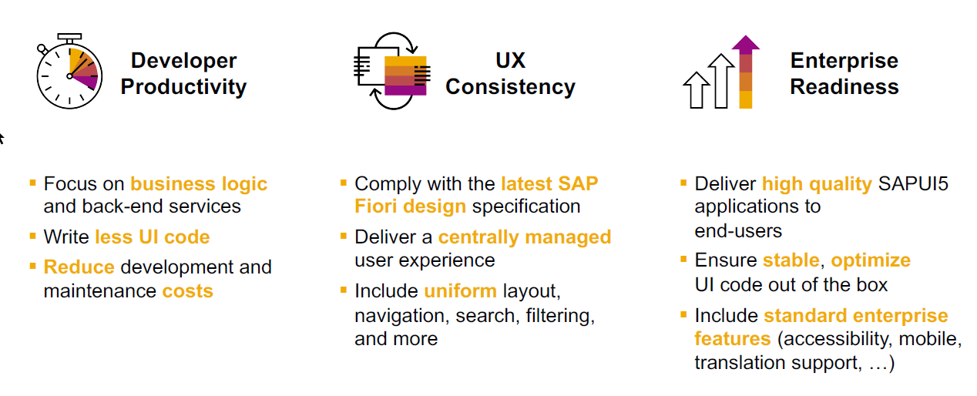
SAP Fiori elements boosts SAP Fiori development efficiency
www.anubhavtrainings.com

Slide 6
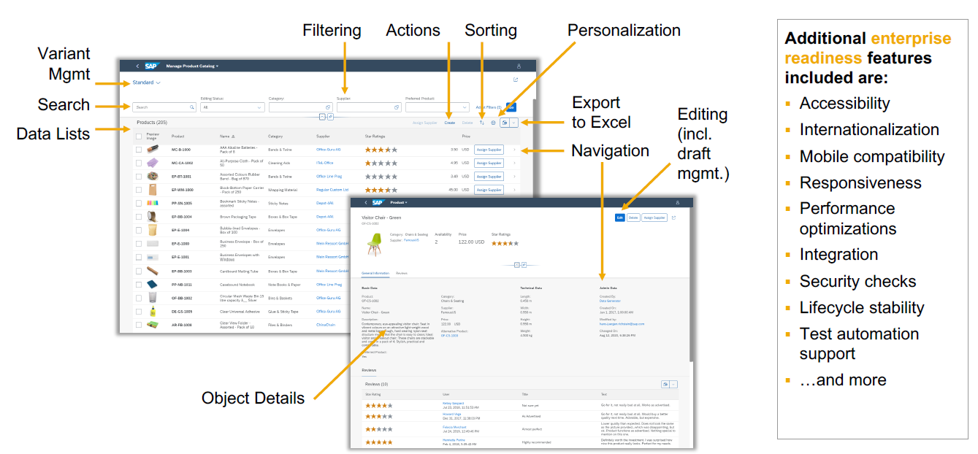
SAP Fiori elements provides enterprise-ready apps out of the box
www.anubhavtrainings.com

Slide 7
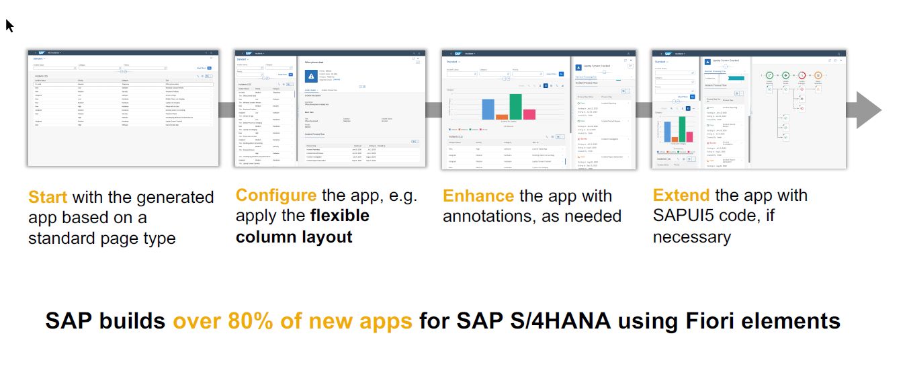
SAP Fiori elements application architecture provides flexibility
www.anubhavtrainings.com

Slide 8

SAP Fiori elements prioritizes efficiency over flexibility
www.anubhavtrainings.com

Slide 9

Summarize
LET’S SUMMARISE!

Slide 10

Summarize
End of Day 14

Slide 12


We’re committed to empower you to be
#FutureReady
through powerful training solutions.
We build the workforce of the future.
250+
Corporate Clients
30,000+
Learners Trained
25000+
Learners Placed
FREE WEBINARS
Sign up for free webinars with industry experts every fortnight!
Enroll Now!
Contact us today!
https://anubhavtrainings.com

